Slide 1



Welcome to
Intro to Web
Development
Part A
Instructor: La’Von LaMar Towns

Slide 2


Course Directions
1
2
3
4
5
6
You must view every lesson to pass this ecourse.
You must score 75% or higher to pass this ecourse.
Unanswered questions on any page will be counted wrong.
The certificate page is viewable only if you pass the ecourse.
If you score below 75%, you will be taken back to the title page so you can review the lessons and correct mistakes.
You can stop after any lesson and pick up where you left off later.

Slide 3

Lesson #
Getting Started with HTML
Click anywhere on the slide to start the lesson!

Slide 4

Lesson Navigation
Choose what to do next ! Just click a button below !
Video
(Watch it!)
Slides
(Study it!)
Quiz
(Review it!)
Exercise
(Master it!)

Slide 5
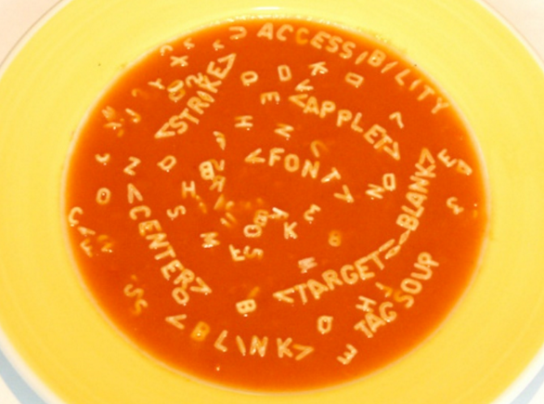
The Fundamentals
HTML is the key essential element in web development.
It makes up the underlying structure of all webpages.
Key Notes
HTML is a markup language meaning Hyper Text Markup Language.
A good way to learn HTML is to look at your favorite HTML pages and pressing Ctrl+U.
HTML elements are the building block to an HTML doc.
Notes:
You can add as many information slides as you want after each Section Title slide. The key is variety, variety, variety. Absolutely no one wants to read paragraphs of information on screen after screen. Use graphs, charts, tables, infographics, clipart, videos, and screenshots liberally to liven up your presentation!

Slide 6

Need to Know
<>some text</>>
Tags
Notes:
Do not skip this slide. Retention goes up dramatically when you remember this one trick: Tell them what you told them!

Slide 7


Need to Know
The head tag contains important information about the document, like the title and links to stylesheets or frameworks.
ALL of the content, such as paragraphs, are contained within the body.
<head>some text</head>>
<body>some text</body>>
Notes:
Do not skip this slide. Retention goes up dramatically when you remember this one trick: Tell them what you told them!

Slide 8
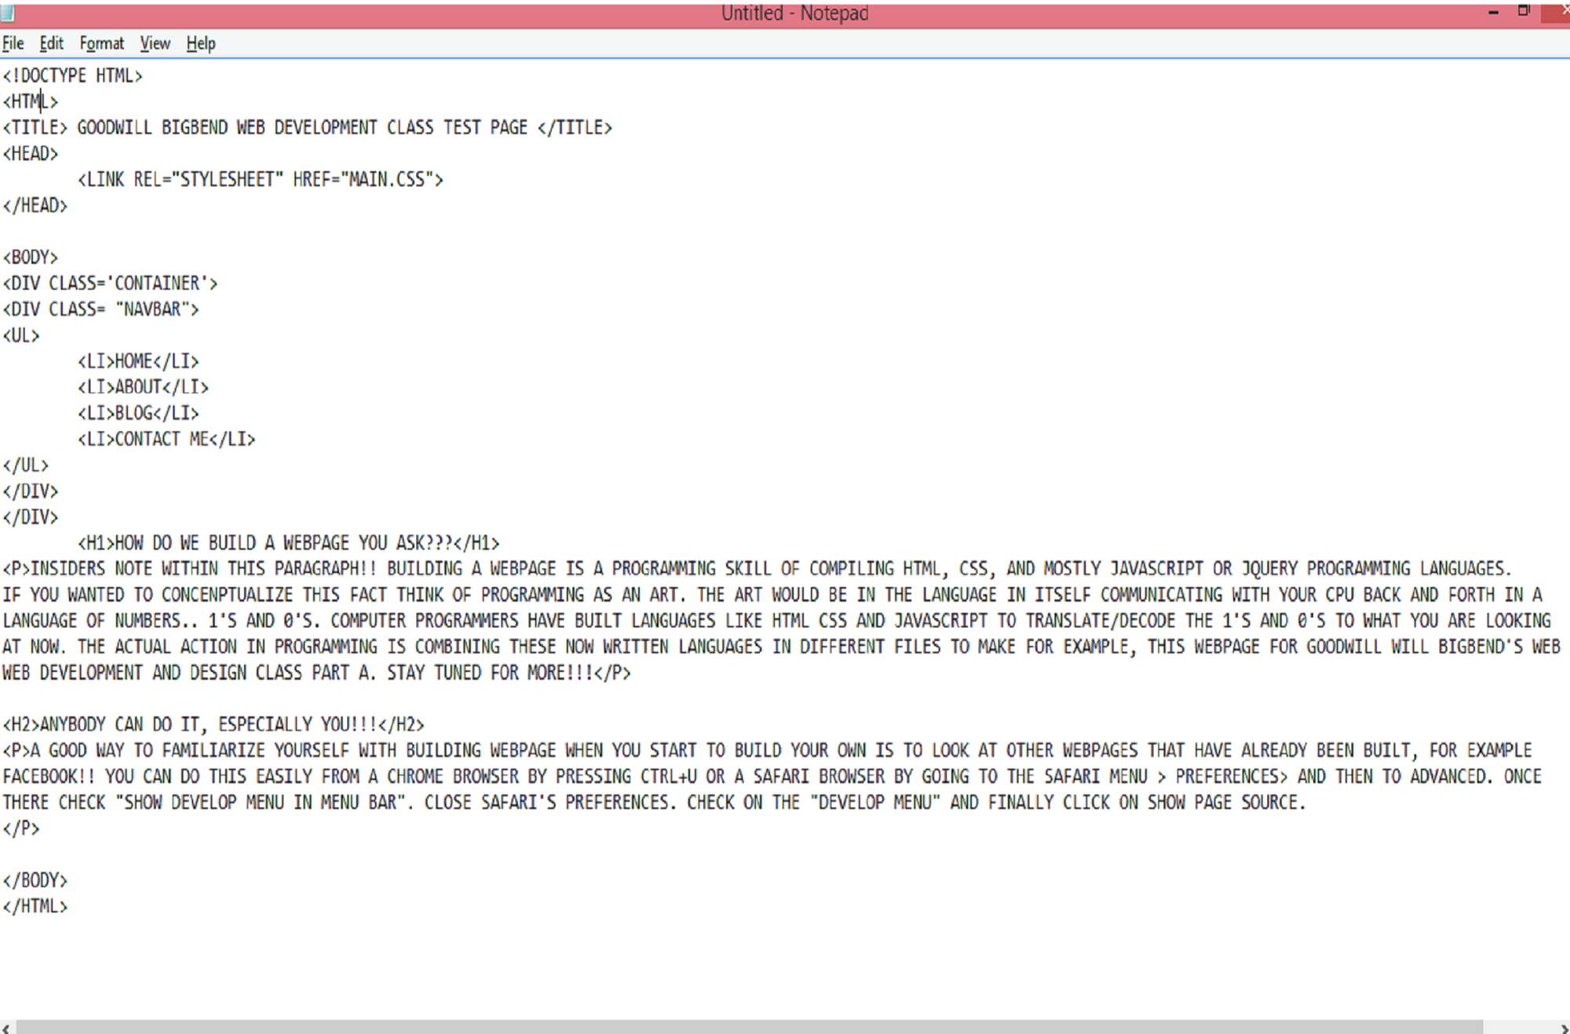

Notes:
If you use a video or screen shot, it will actually fill up the entire screen. I only included the background here in case you use some other form of graphic.

Slide 9
BODY
OUTER WRAPPER
The Body
All of your content is stored in the body of your document
HEADER
MAIN WRAPPER
SIDEBAR
POST
Key Notes
In your body you will find groups of heading tags
There are 6 levels of headings in HTML <h1></h1>:<h6></h6>
Paragraphs are usually always nested under headings, It is also a good practice in the art of code, called “writing clean code.”
FOOTER
Notes:
You can add as many information slides as you want after each Section Title slide. The key is variety, variety, variety. Absolutely no one wants to read paragraphs of information on screen after screen. Use graphs, charts, tables, infographics, clipart, videos, and screenshots liberally to liven up your presentation!

Slide 10

What Goes in the
Body of the Doc
HTML Images
HTML Links
HTML Paragraphs
HTML Headings
Notes:
Do not skip this slide. Retention goes up dramatically when you remember this one trick: Tell them what you told them!

Slide 11
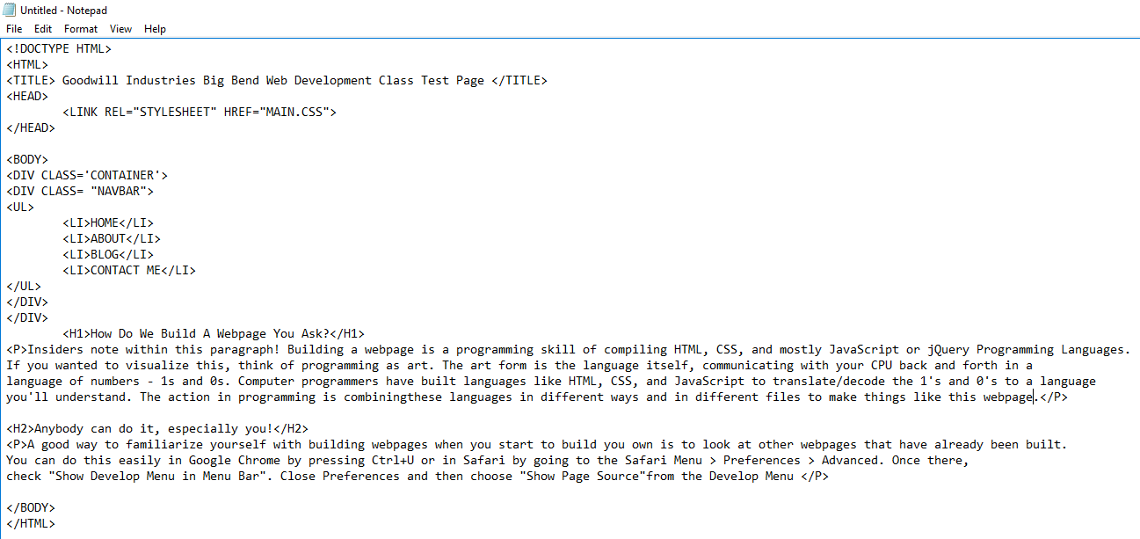
Notes:
If you use a video or screen shot, it will actually fill up the entire screen. I only included the background here in case you use some other form of graphic.

Slide 12
Add Images to HTML
You can add images to your webpage by typing the following where “someimage.png” is the name of your file.
<img src=“someimage.png”>
Key Notes
The first thing you need when adding images to your document is an anchor tag <a> and an attribute <href>. It should look like this:
Another common practice is to give your images nicknames, or in the world of HTML, alternate names!
<a href=“someimage.jpg”/>
Notes:
You can add as many information slides as you want after each Section Title slide. The key is variety, variety, variety. Absolutely no one wants to read paragraphs of information on screen after screen. Use graphs, charts, tables, infographics, clipart, videos, and screenshots liberally to liven up your presentation!

Slide 13
Need to Know
If you compress your images before adding them to your HTML document, you can greatly decrease load time.
The <img> tag is a self closing tag.
You can manipulate the size of your image by adding a style attribute and value
<img src=“someimage.jpg” alt=someimg/>
Notes:
Do not skip this slide. Retention goes up dramatically when you remember this one trick: Tell them what you told them!

Slide 14
Notes:
If you use a video or screen shot, it will actually fill up the entire screen. I only included the background here in case you use some other form of graphic.

Slide 15
Review
What is HTML and what does it stand for?
What is contained inside the body of an HTML Doc?
How do we add images to our HTML Doc?
Notes:
Do not skip this slide. Retention goes up dramatically when you remember this one trick: Tell them what you told them!

Slide 16

You Got This!
Lesson Quiz!
Click the slide to start the quiz!

Slide 17

Lesson Exercise
1 Download the exercise file below and open the file.
(you must have Office 2013 on your PC).
2 Step Two
3 Step Three
4 Step Four
5 Step Five

Slide 18

Video Presentation
Learning the Structure of HTML
Start the video by clicking anywhere on the slide!

Slide 19
Lesson Navigation
Study the way you learn best ! Play the video. Review the slides. Or do both. Just click a button below to begin !
Video
(Watch it!)
Slides
(Study it!)
Quiz
(Review it!)
Exercise
(Master it!)

Slide 20
Making Lists
Other than images, lists are probably the most common type of element in HTML.
Keynotes
Ordered Lists are simply numbered list that we can add to headings and paragraphs.
Unordered Lists are just the opposite –they aren’t numbered and can be added as part of any heading or paragraph element.
<ol></ol>
<ul></ul>

Slide 21
Need to Know
The List element is always found nested inside either an ordered list or an unordered list.
When you nest tags, the last tag you open is the first one you close
<li> “someitem”</li>
<p> <li> “someitem”</li> </p>
Notes:
Do not skip this slide. Retention goes up dramatically when you remember this one trick: Tell them what you told them!

Slide 22
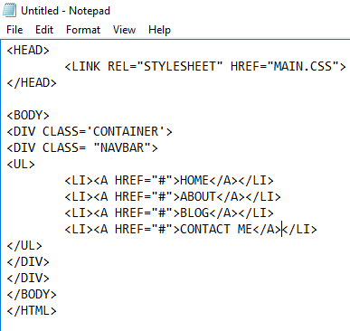
As you can see, the <li> list element is nested inside the <ul> unordered list element

Slide 23
Styling the Font
You have the ability with HTML to write styling rules “inline.”
This means you don’t have to write them in a separate file.
Subheading
We can give tags more instruction by adding an attribute and value. For example, to change font size of a paragraph you should type this:
<p style=“font-size=40px”/>

Slide 24
Need to Know
A Unique Common Practice for writing good clean code is the use of comments! Use these to lay down your engineering brain crumbs just in case you get lost or confused
With the <style> attribute you can also change the background of any HTML element, It should look the same as changing the font in HTML
<!—this is how a comment looks in HTML–>
<li style=“background-color: brown;”> # </li>
Notes:
Do not skip this slide. Retention goes up dramatically when you remember this one trick: Tell them what you told them!

Slide 25
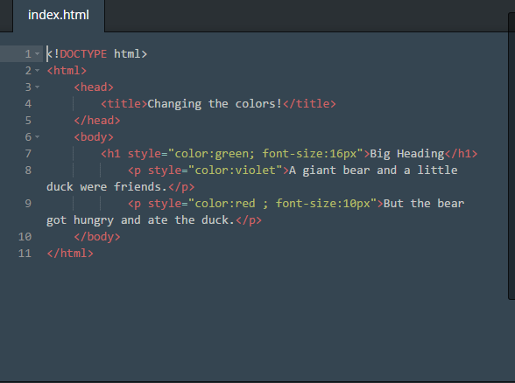
NOTICE THE INLINE STYLING?

Slide 26
Review
We can style our HTML by adding a style a ___ and ___? (fill in the blank).
Lists elements are ____ inside unordered or ordered lists elements (fill in the blank).
Why do we “comment” in HTML?
Notes:
Kilobyte is one paragraph of text.
Megabyte is one minute MP3 music track.
Gigabyte is ten yards of books on a shelf.
Terabyte is 250000 MP3 music tracks.
Petabyte is 50 billion pages of text.

Slide 27

Stumped?
Could you just use either all spans or all div tags in your HTML doc?
Name one thing all tables have in common.
How is a table equivalent to an excel document?

Slide 28
Tables, Divs, and Spans
Notes:
Kilobyte is one paragraph of text.
Megabyte is one minute MP3 music track.
Gigabyte is ten yards of books on a shelf.
Terabyte is 250000 MP3 music tracks.
Petabyte is 50 billion pages of text.

Slide 29
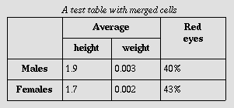
Tables
There are many ways we can structure our HTML doc and one of the most common techniques is the use of tables
A test table with merged cells
Average
Red Eyes
height
weight
Males
1.9
0.003
40%
Females
1.7
0.002
43%
Notes:
Kilobyte is one paragraph of text.
Megabyte is one minute MP3 music track.
Gigabyte is ten yards of books on a shelf.
Terabyte is 250000 MP3 music tracks.
Petabyte is 50 billion pages of text.

Slide 30
Lets “Table” It
Tables can be any developers best friend because they allow us to store data so it can be easy to read. What you will need to start a table is the <table> tag.
A table is the equivalent to an Excel table, which means a table is just a bunch of information or data lined up as rows. To create a table row you need the <tr> tag.. We don’t actually create columns in tables, that is determined by the number of cells in your table row <tr>
Notes:
Kilobyte is one paragraph of text.
Megabyte is one minute MP3 music track.
Gigabyte is ten yards of books on a shelf.
Terabyte is 250000 MP3 music tracks.
Petabyte is 50 billion pages of text.

Slide 31
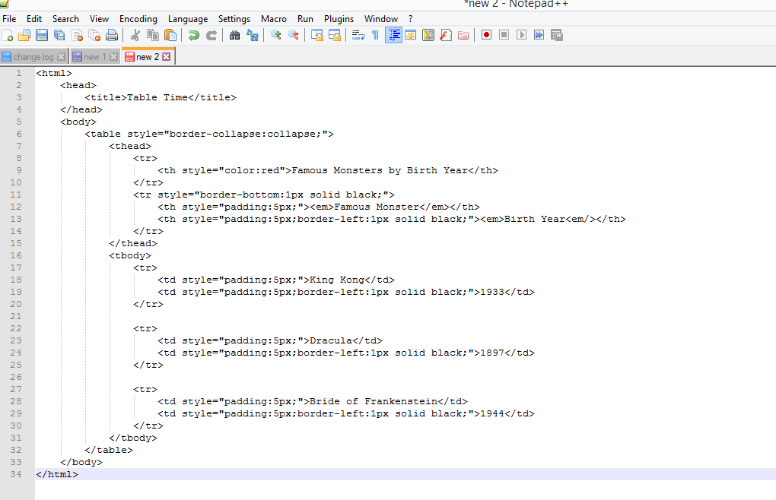
Notes:
Kilobyte is one paragraph of text.
Megabyte is one minute MP3 music track.
Gigabyte is ten yards of books on a shelf.
Terabyte is 250000 MP3 music tracks.
Petabyte is 50 billion pages of text.

Slide 32
Need to Know
Just like our HTML DOC. Our table needs a head. A <thead> tag can store important information in identifying anything about the table. For instance a name
Just like our HTML document, our table also needs a body or a <tbody> tag that store the actual data for our table
Notes:
Do not skip this slide. Retention goes up dramatically when you remember this one trick: Tell them what you told them!

Slide 33
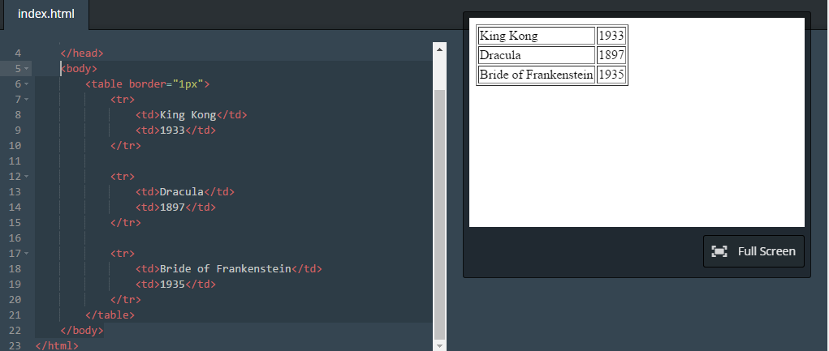
Notes:
Kilobyte is one paragraph of text.
Megabyte is one minute MP3 music track.
Gigabyte is ten yards of books on a shelf.
Terabyte is 250000 MP3 music tracks.
Petabyte is 50 billion pages of text.

Slide 34

Div = Divide
The tag is short for division in HTML. It allows you to divide your entire document up which will come in handy once we learn CSS
One thing <div>’s allow you to do is to make divs or “Objects” clickable/manageable.
<div> </div>
Notes:
Kilobyte is one paragraph of text.
Megabyte is one minute MP3 music track.
Gigabyte is ten yards of books on a shelf.
Terabyte is 250000 MP3 music tracks.
Petabyte is 50 billion pages of text.

Slide 35
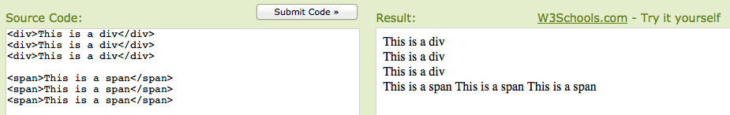
Difference Between Div & Span
The difference between <div> and <span> elements is that the <div> element allows you to divide and manipulate divisions of your HTML document, while the <span> element allows you to control smaller manipulations, such as text.
Notes:
Kilobyte is one paragraph of text.
Megabyte is one minute MP3 music track.
Gigabyte is ten yards of books on a shelf.
Terabyte is 250000 MP3 music tracks.
Petabyte is 50 billion pages of text.

Slide 36
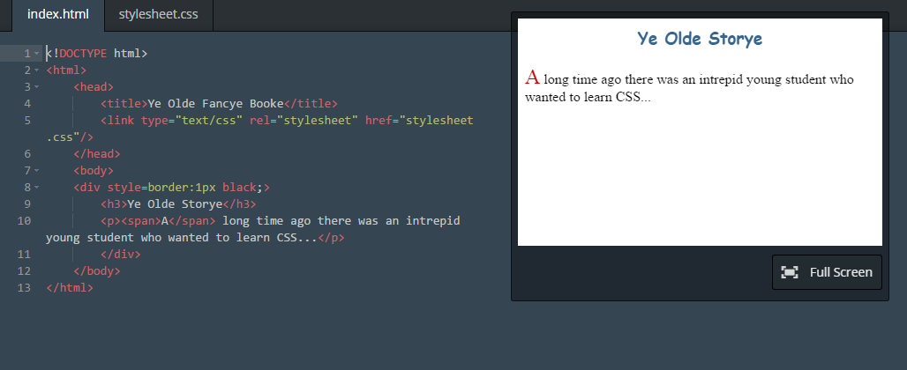
Notes:
Kilobyte is one paragraph of text.
Megabyte is one minute MP3 music track.
Gigabyte is ten yards of books on a shelf.
Terabyte is 250000 MP3 music tracks.
Petabyte is 50 billion pages of text.

Slide 37
You Got This!
Lesson Quiz!
Click the slide to start the quiz!

Slide 38
Lesson Exercise
1 Download the exercise file below and open the file.
(you must have Office 2013 on your PC).
2 Step Two
3 Step Three
4 Step Four
5 Step Five

Slide 39

Slide Presentation
Forms in HTML
Review the presentation by clicking on each slide!

Slide 40
Lesson Navigation
Choose what to do next ! Just click a button below !
Video
(Watch it!)
Slides
(Study it!)
Quiz
(Review it!)
Exercise
(Master it!)

Slide 41
You Got This!
Lesson Quiz!
Click the slide to start the quiz!

Slide 42
Lesson Exercise
1 Download the exercise file below and open the file.
(you must have Office 2013 on your PC).
2 Step Two
3 Step Three
4 Step Four
5 Step Five

